Slide 1


Introduction to HTML
Tags, Attributes

Slide 2
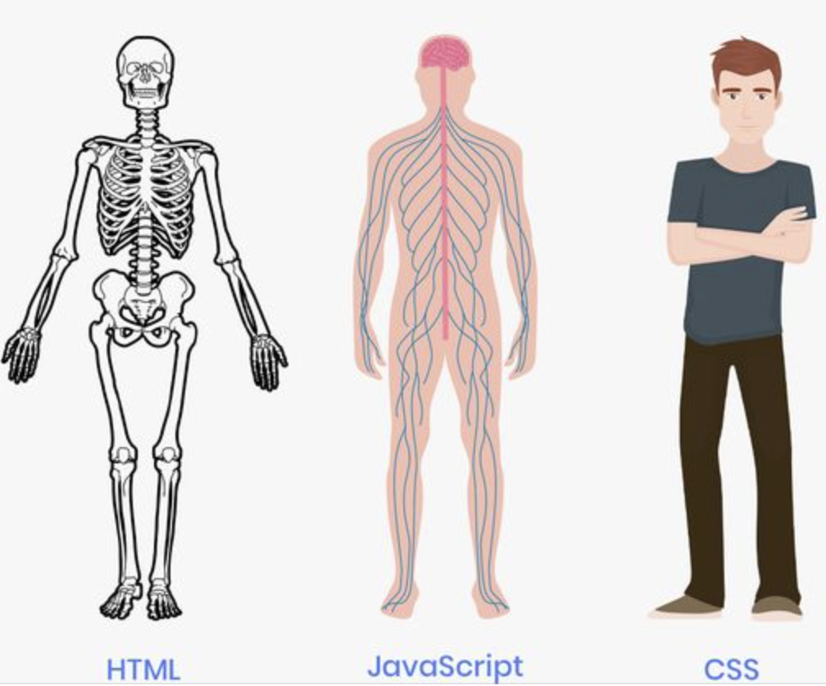
What is HTML ?
HTML (HyperText Markup Language) is the code that is used to structure a web page and its content.

Slide 3
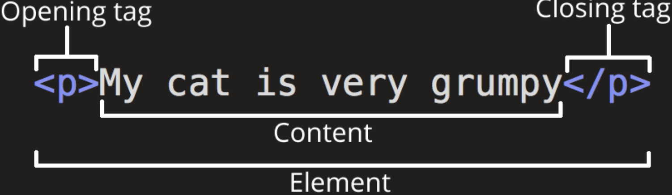
HTML Tag
An HTML tag is a piece of markup language used to indicate the beginning and end of an HTML element in an HTML document. As part of an HTML element, HTML tags help web browsers convert HTML documents into web pages.

Slide 4
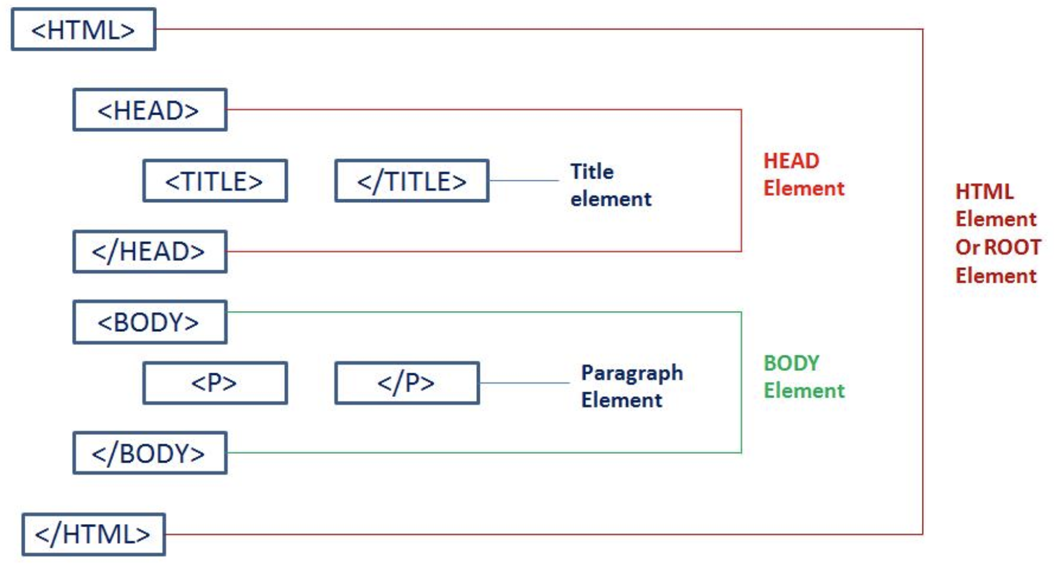
HTML Structure
The <html> tag represents the root of an HTML document.
The <head> element is a container for metadata (data about data) and is placed between the <html> tag and the <body> tag.
The <title> tag defines the title of the document. The title must be text-only, and it is shown in the browser's title bar or in the page's tab.
The <body> tag defines the document's body.

Slide 5
Popular Tags
<h1> - <h6> These are a group of heading tags used to create heading in a webpage
<p> It defines the paragraph in a webpage.
<span> It defines the span in a webpage.
<b> It is used to define bold text.
<i> It makes text italic and is used to define technical terms, idiomatic text.
<small> Used to define smaller text like copyright, comments, etc. <div> It defines a group of elements within the HTML document.
<footer> It defines footer of the webpage or a section
<br> Line break
<hr> Horizontal Line

Slide 6
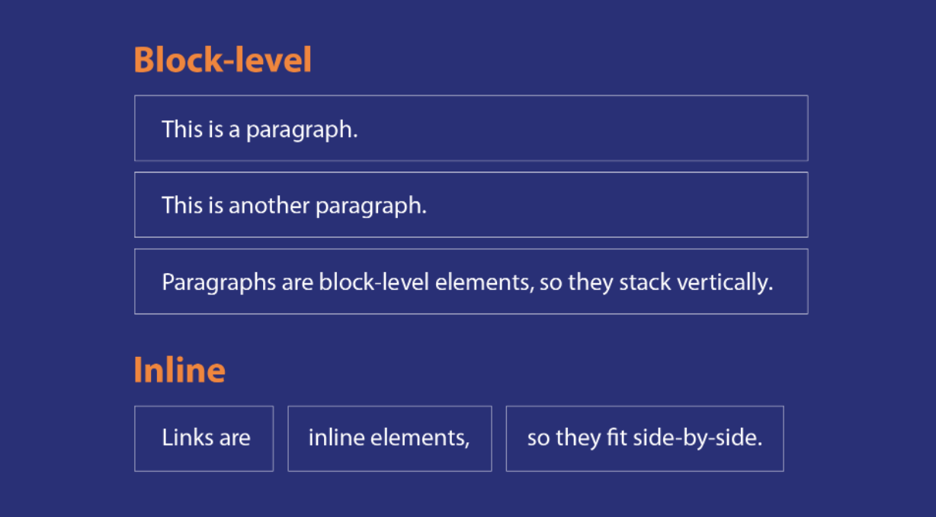
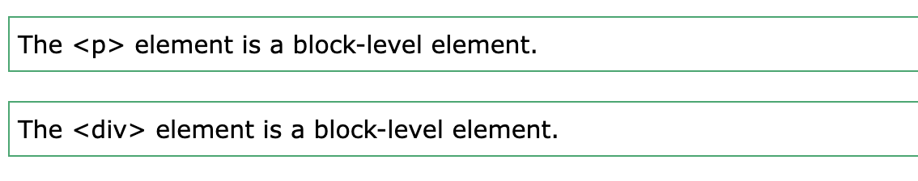
HTML Block and Inline Elements Every HTML element has a default display value, depending on what type of element it is. There are two display values: block and inline
A block-level element always starts on a new line,
and the browsers automatically add some
space (a margin) before and after the element.
An inline element does not start on a new line.
<b>, <i>, <span>

Slide 7
Image, Link, Attributes
**HTML attributes provide additional information about HTML elements.

Slide 8
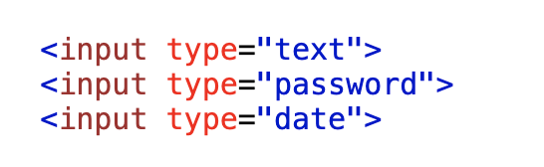
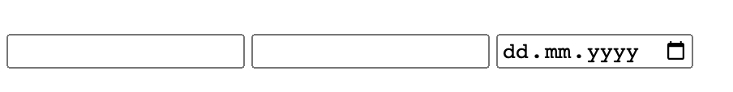


Input, Button
The <input> tag specifies an input field where the user can enter data.
The <input> element can be displayed in several ways, depending on the type attribute.
The <button> tag defines a clickable button.
Inside a element you can put text (and tags like <i>, <b>, <strong>, <br>, <img>, etc.).
That is not possible with a button created with the <input> element!

Slide 9
Iframe
The <iframe> tag specifies an inline frame.
An inline frame is used to embed another document within the current HTML document.

Slide 10
Meta Tag
The <meta> tag defines metadata about an HTML document.
Metadata is data (information) about html page content.
<meta name="author" content="John Doe"> - Define the author of a page
<meta name='language' content='ES’> - Define the language of page
<meta http-equiv="refresh" content="30"> - Refresh document every 30 seconds:

